Slide 1




Econometrics Project
Economic and Structural Drivers of Regional Unemployment in 9 European Countries
Belgium , Bulgaria, Czechia, Denmark, Germany, Estonia, Ireland, Greece, Spain
A NUTS-2 Level Analysis (2022)
Secărea Diana, Sandu Leonard, Smeu Estera
Vătui Rebeca

Slide 2


Introduction
Unemployment in the European Union has an unfortunate habit of clustering in some regions while politely avoiding others. Let’s see what happened in Belgium , Bulgaria, Czechia, Denmark, Germany, Estonia, Ireland, Greece, Spain.
In 2022, a few NUTS-2 regions were practically running out of unemployed people, while others appeared to be collecting them.
This study uses a linear regression model to investigate unemployment using Eurostat data. The analysis examines whether being richer, more educated, less rural, or simply located in the “right” part makes finding a job statistically easier.

Slide 3


Literature review
Regional labor market outcomes are primarily determined by macroeconomic performance, economic structure, and human capital. Classical theories view unemployment as the result of insufficient demand and structural mismatches, occurring when “the economic system fails to provide employment for all who are willing and able to work” (The Economics of Unemployment, by J. A. Hobbson, publisher: World Public). This framework supports analyzing unemployment as a function of regional economic characteristics rather than individual behavior.
Economic output is a central explanatory factor. GDP growth is closely linked to employment creation, as “when real GDP is growing strongly, employment is likely to be increasing” (Gross Domestic Product: An Economy’s All, Tim Callen). Accordingly, GDP per capita is widely used as a proxy for regional economic development and is expected to be negatively associated with unemployment.

Slide 4
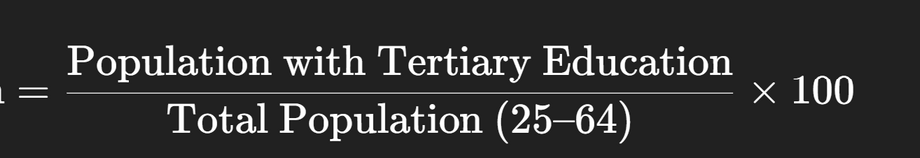
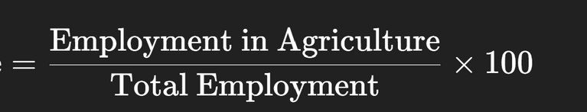
Methodology
Defining the Variables for Linear Regression Analysis at NUTS-2 level for the year 2022
01
Unemployment Rate (%)
=(Number of Unemployed Persons/ Labour Force)​×100
Dependent variable, defined as the percentage of the labour force that is unemployed (persons without work, available for work, and actively seeking work in the reference period). This is an ILO-standardized rate for ages 15–74, sourced from the EU Labour Force Survey .
02
Tertiary Education (% population)
Independent variable, the share of adult population a tertiary (higher) education (ISCED levels 5–8). It is computed as the percentage of people who have successfully completed a university or equivalent level of education. This is a proxy for human capital; regions with a higher skilled workforce may experience lower unemployment .
03
Employment by agricultural activity
Independent variable, the proportion of total regional employment in the agriculture, forestry and fishing sector. This indicator reflects the economic structure of the region (primary-sector dependence). Regions with very high agricultural shares (rural) may have different unemployment dynamics compared to industrial regions.

Slide 5
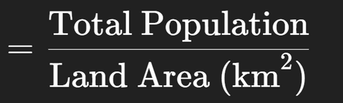
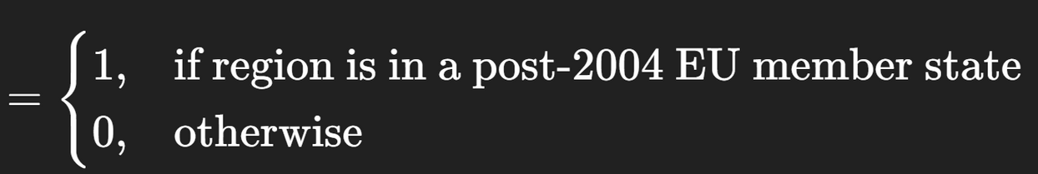
Methodology
04
GDP per Capita PPS
=Total Regional GDP / Total Population​
Independent variable measured as regional gross domestic product per inhabitant in purchasing power standards, as a percentage of the EU27 average. This indicator captures regional economic prosperity adjusted for price level differences.
05
Population Density (persons/km²)
Independent variable, number of inhabitants per square kilometer in the region. This serves as a proxy for urbanization. Densely populated, urban regions often benefit from agglomeration economies that can lower unemployment, whereas sparsely populated regions may face structural unemployment challenges.
06
CEE Dummy (Eastern Europe =1):
Independent dummy variable. Binary variable equal to 1 for regions located in Central and Eastern European EU member states (Bulgaria, Czechia, Estonia) and 0 otherwise. The dummy captures structural and historical differences in labor markets between post-socialist economies and older EU member states.

Slide 6
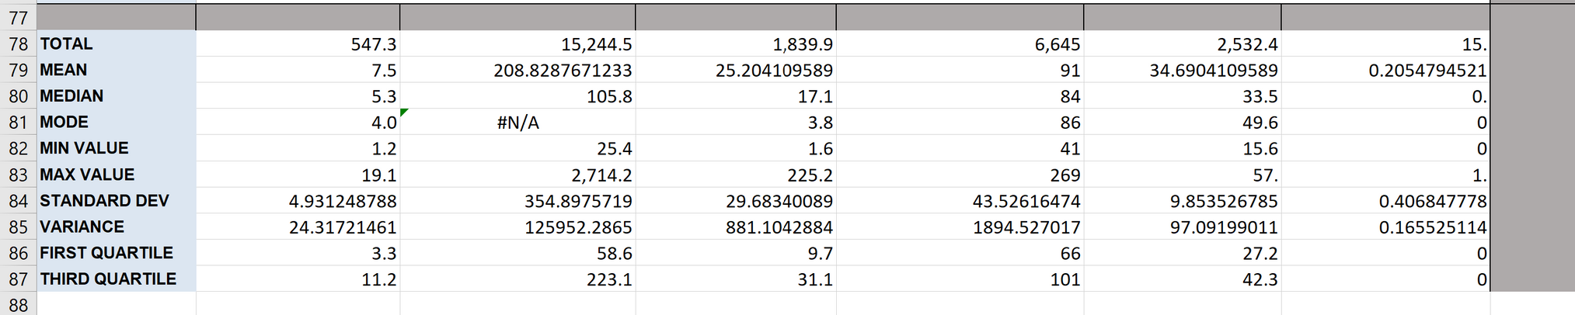
Data Cleaning
After merging all datasets and removing regions with missing or unreliable observations, a balanced cross-sectional dataset was obtained. The final sample includes aprox 75 NUTS-2 regions from 9 EU countries for the year 2022. No missing values remain in the dataset, therefore ensuring a complete dataset with values well above the minimum required sample size (30).
The descriptive statistics reveal substantial regional disparities in unemployment, income, population density, and economic structure, justifying the inclusion of structural and socio-economic variables in the regression analysis.

Slide 7
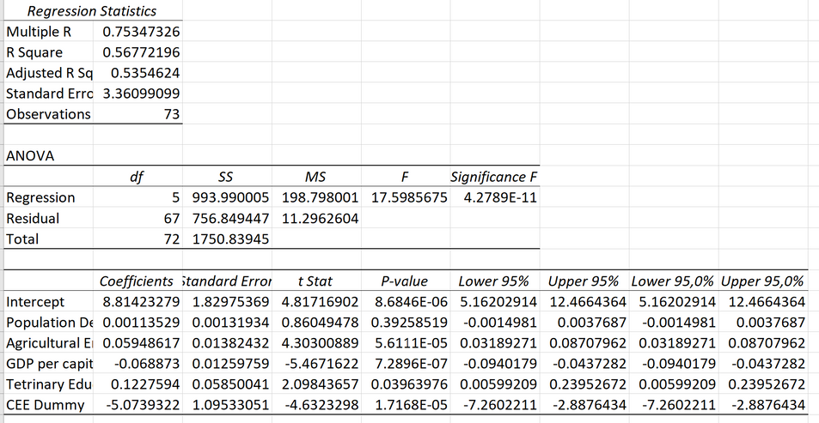
Methodology
Definition Model 1
Including Dummy
The model is highly statistically significant overall.
Unemployment Rate = β₀ + β₁(Population Density) + β₂(Agricultural Employment) + β₃(GDP per capita) + β₄(Tertiary Education) + β₅(CEE Dummy) + ε
Expected results:
-CEE regions have 5.07 percentage points lower unemployment on average (controlling for other factors)
-Higher GDP per capita reduces unemployment significantly
The CEE dummy is highly significant (p < 0.001), capturing labor market characteristics not explained by economic variables alone, such as:
Historical legacy of socialist economies
Different labor market institutions
Structural transformation patterns

Slide 8
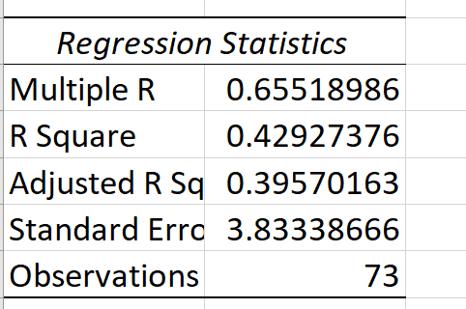
Methodology
Definition Model 2
Excluding Dummy
The model is statistically significant overall, but explains less variation than the model with the dummy
Unemployment Rate = β₀ + β₁(Population Density) + β₂(Agricultural Employment) + β₃(GDP per capita) + β₄(Tertiary Education) + ε
Expected Results:
-Without the CEE dummy, the model appears to fit better (higher R²)
-However, this masks structural differences between EU member states
-Tertiary education coefficient changes sign (from + to -), suggesting omitted variable bias
-The CEE dummy captures important institutional and historical differences
The sign reversal on tertiary education (from +0.1228 to -0.3368) suggests omitted variable bias.

Slide 9


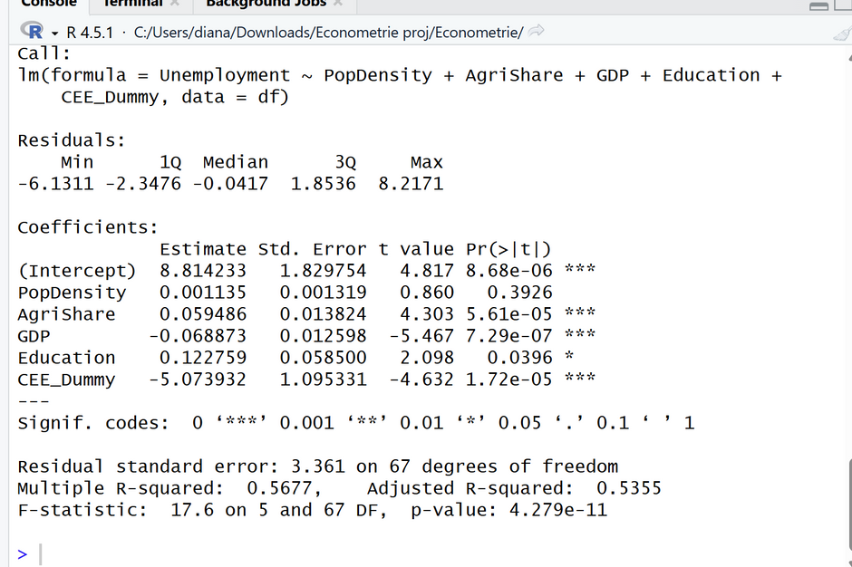
R analysis: Model 1
Model 1 explains 56.8% of the variation in unemployment
R2=0.568R^2 = 0.568R2=0.568
indicating a strong explanatory capacity.
Model 1 performs substantially better than Model 2
RModel B2=0.429R^2_{Model\ 2} = 0.429RModel B2​=0.429
suggesting that the inclusion of additional regressors—particularly the CEE dummy variable—significantly improves the model’s ability to explain unemployment differences across regions.

Slide 10
R analysis: Model 1
GDP (−0.069, p < 0.001): Higher GDP is associated with lower unemployment.
A one-unit increase in GDP reduces the unemployment rate by approximately 0.07 percentage points, holding all other factors constant.
This result aligns with economic theory: stronger economic performance generates more employment opportunities.
Agricultural Share (+0.059, p < 0.001): Regions with a larger agricultural sector experience higher unemployment.
A one percentage point increase in the agricultural share raises unemployment by about 0.06 percentage points, reflecting lower productivity, seasonality, and structural rigidities often present in agriculture-based economies.
CEE Dummy (−5.07, p < 0.001): Being located in a Central or Eastern European (CEE) region reduces the unemployment rate by 5.07 percentage points relative to non-CEE regions, ceteris paribus.
This highlights the presence of systematic regional labor-market differences not fully captured by economic and demographic variables alone.

Slide 11

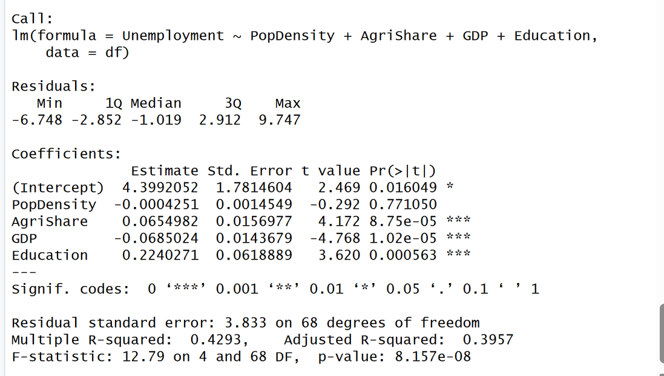



R analysis: Model 2
GDP (−0.0685, p < 0.001)
Higher GDP significantly reduces unemployment.
A one-unit increase in GDP lowers unemployment by approximately 0.07 percentage points, confirming the role of economic growth in job creation.
Agricultural Share (+0.0655, p < 0.001)
Regions with a higher reliance on agriculture experience higher unemployment.
This reflects structural inefficiencies, lower productivity, and seasonality in agricultural sectors.
Education (+0.224, p < 0.001)
Higher education levels are associated with higher unemployment.
This may indicate skills mismatch, delayed labor market entry, or overqualification in some regions.
Population Density (−0.0004, not significant)
Population density has no statistically significant effect on unemployment in this model.
Model B provides a statistically valid but less comprehensive explanation of unemployment compared to Model A.

Slide 12
Comparison with Model 1 (Interpretative Insight)
Model 2 omits the CEE regional dummy, leading to:
Lower explanatory power (R² = 0.429 vs. 0.568)
Larger residual variance
Potential omitted variable bias
The stronger performance of Model 1 suggests that regional characteristics play a crucial role in explaining unemployment differences.
Final Assessment
While Model 2 identifies important economic drivers of unemployment, it fails to capture systematic regional effects, making it inferior to Model 1 for policy analysis and inference. Model 1 not only fits the data better than Model 2 but also yields statistically significant and economically meaningful coefficients, confirming the importance of economic performance, sectoral structure, and regional characteristics in explaining unemployment differences.

Slide 13

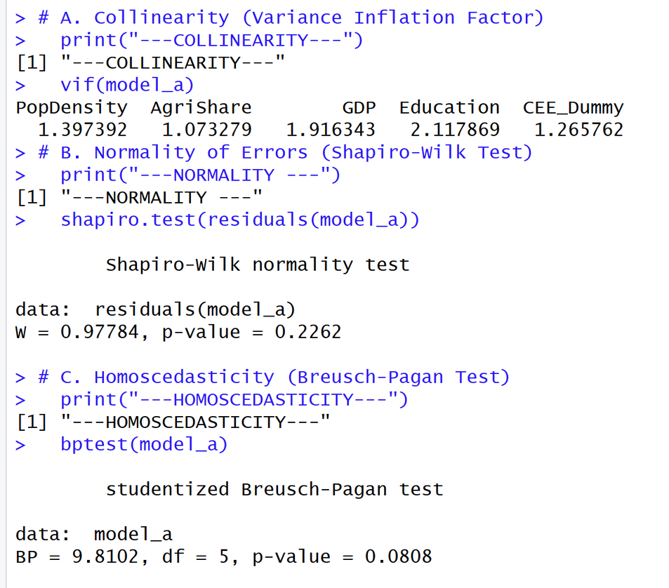
Linear regression model 1 assumptions
✔ Collinearity assumption satisfied
All VIF values are well below 5 (and far below 10).
This indicates no serious multicollinearity among regressors.
Coefficient estimates are stable and reliable.
✔ Normality assumption satisfied
The null hypothesis of normally distributed residuals cannot be rejected.
Residuals are approximately normal.
→ Validates the use of t-tests and F-tests for inference.
✔ Homoscedasticity assumption broadly satisfied
The null hypothesis of constant error variance cannot be rejected at the 5% level.
There is no strong evidence of heteroscedasticity.
At most, there is weak heteroscedasticity at the 10% level, but not severe.

Slide 14
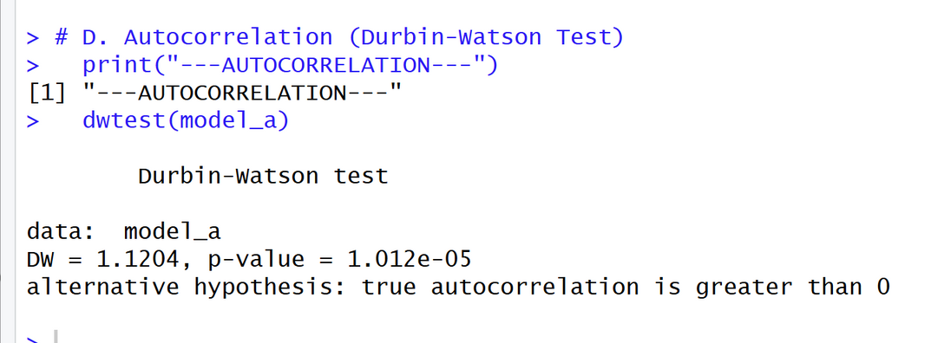
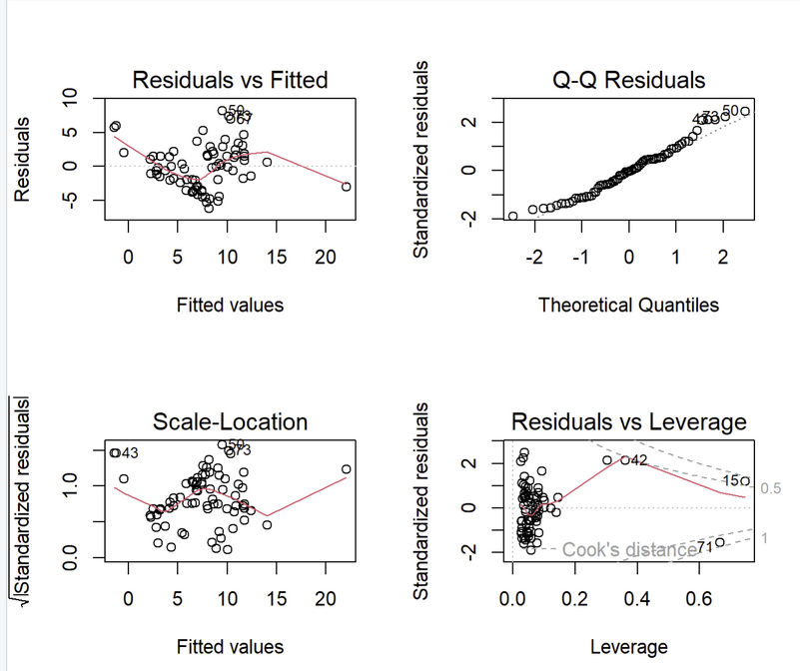
Linear regression model 1 assumptions
Autocorrelation (Durbin–Watson Test)
Durbin–Watson statistic: DW = 1.12
p-value: < 0.001
Interpretation
The Durbin–Watson statistic is
substantially below 2,
indicating positive autocorrelation in the residuals.
The very small p-value leads to rejection of the null hypothesis of no autocorrelation.This suggests that error terms are systematically correlated, violating the independence assumption of OLS.
Implications for Model A
Coefficient estimates remain unbiased, but:
Standard errors may be underestimated
t-statistics may be overstated
As a result, statistical significance should be
interpreted with some caution.
Possible Explanations & Remedies
Autocorrelation may arise from:
Spatial dependence across regions
Omitted regional or temporal factors
Structural similarities between neighboring regions

Slide 15
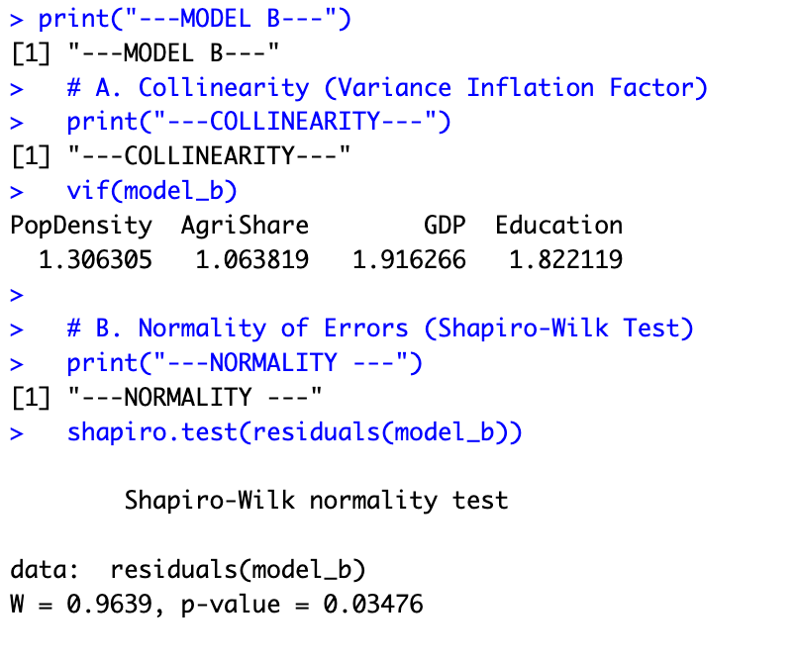
Linear regression model 2 assumptions
✔ Collinearity assumption satisfied
All VIF values are well below 5 (ranging from 1.06 to 1.92).
This indicates no serious multicollinearity among regressors.
Coefficient estimates are stable and reliable.
✔ Normality assumption rejected
The null hypothesis of normally distributed residuals is rejected at the 5% significance level
Residuals are approximately normal.
→ The residuals deviate significantly from a normal distribution. While OLS estimators remain unbiased, standard inference may be less reliable.

Slide 16
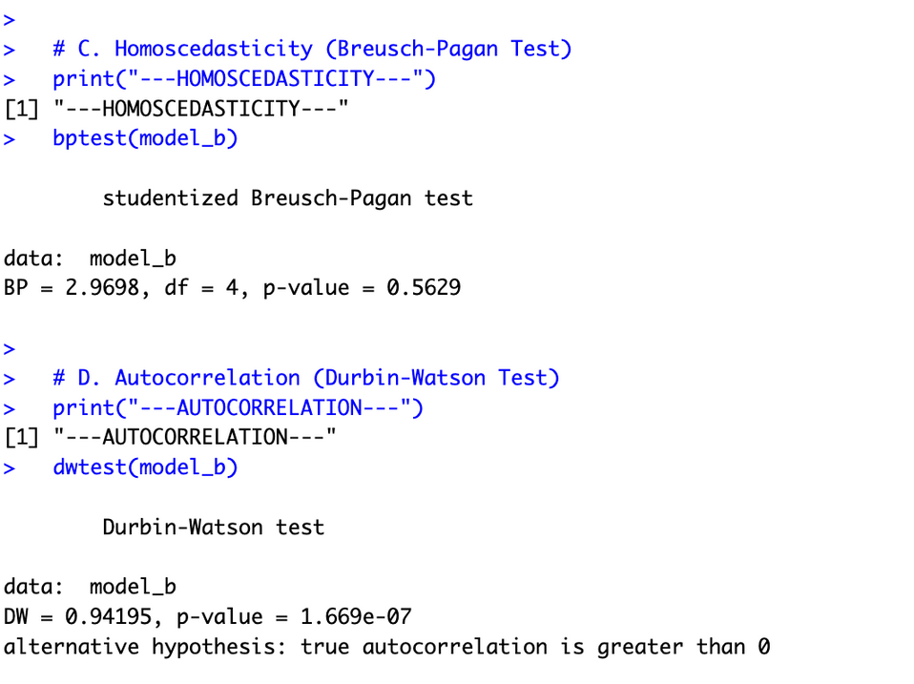
Linear regression model 2 assumptions
✔ Homoscedasticity assumption broadly satisfied
The null hypothesis of constant error variance cannot be rejected at the 5% level.
Unlike model A, there is no evidence of heteteroscedasticity in this model. The variance of error terms appears constant across observations
Autocorrelation
The Durbin-Watson statistic is substantially bellow 2 (and lower than model A). The value of 0.94 indicates strong positive autocorrelation in the residuals.
The very small p-vvalue leads to a definitive rejection of the null hypothesis of no autocorrelation.
✔ Implications of Model B
! Systematic spatial patterns in the omitted variable (Region) are now trapped in the error term.
The failure to include the CEE_Dummy (wich was significant in model A) has likely exarcerbated the autocorrelation, as the model is trying to fit a “one size fits all” line to distinct regional clusters

Slide 17

Limitations
Spatial Autocorrelation: The Durbin-Watson test failed, indicating autocorrelation. This is a common limitation in regional economic data, as unemployment in one region often affects neighboring regions. Future research could use a Spatial Error Model to correct this.
Limited Regional Coverage: Due to data availability constraints in Eurostat, the analysis is restricted to 9 NUTS-2 regions for which consistent data across all variables could be obtained.
Several EU regions were excluded because complete or comparable data were not available for all variables of interest.
The reduced regional coverage may limit the representativeness and generalizability of the results to the entire European Union.
Inconsistencies in Eurostat NUTS-2 Regional Definitions: Eurostat NUTS-2 data present structural inconsistencies across datasets and years:
Inconsistent region codes and changes in regional classification complicate data merging and harmonization.

Slide 18
Conclusions
Regional unemployment is driven by economic structure, prosperity, and institutional factors. The CEE dummy is essential for accurate modeling, capturing systematic differences beyond standard economic indicators. Model 1 provides robust, policy-relevant estimates for evidence-based regional development strategies across the EU.

Slide 19
References
📌 1) Unemployment statistics at regional level (2022)
URL: https://ec.europa.eu/eurostat/statistics-explained/index.php?title=Unemployment_statistics_at_regional_level
This page provides regional unemployment rates (NUTS-2) and explains how the 2022 data was compiled and interpreted. European Commission
📌 2) Eurostat news – Real GDP increased in most EU regions in 2023
URL: https://ec.europa.eu/eurostat/web/products-eurostat-news/w/ddn-20250211-2
This news release from 11 February 2025 gives information on GDP developments across EU regions in 2022. European Commission
📌 3) Eurostat news – Which EU regions rely heavily on agriculture?
URL: https://ec.europa.eu/eurostat/web/products-eurostat-news/w/ddn-20221011-1
This article describes regional agricultural employment statistics, including overall employment share in agriculture for the EU. European Commission
📌 4) Unemployment statistics – note on data availability (Mayotte)
URL: https://ec.europa.eu/eurostat/statistics-explained/index.php?title=Unemployment_statistics_at_regional_level
Thank you!

